Slide 1
NCAS, CMS, CEDA and JASMIN: AN OVERVIEW

Slide 2
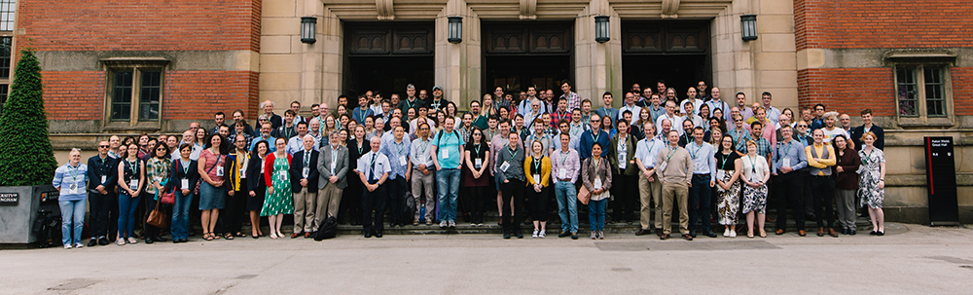

National Centre for Atmospheric Science (NCAS)
> 200 members of staff employed in 12 universities and research institutes around the UK

Slide 3




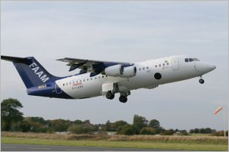
Air Pollution:
Emissions
Urban scale pollution
Health effects
Interaction and feedbacks
Climate and High Impact Weather:
Convective storms
Cyclonic storms
Cold spells, heatwaves, and droughts
Large-scale modes of variability
Long term global change:
Climate projections
Composition changes
Cloud and aerosol feedbacks
Services and Facilities:
Atmospheric Measurement Facility (AMF)
Facility for Airborne Atmospheric Measurements (FAAM)
NERC Facility for Atmospheric Radar Research (NFARR)
Computational Modelling Services (CMS)
Centre for Environmental Data Analysis (CEDA)
“National capability”
Notes:
NCAS carries out research in
- The science of climate change, including modelling and predictions
- Atmospheric composition, including air quality
- Weather, including hazardous weather
- Technologies for observing and modelling the atmosphere
Plus national facilities to support atmospheric science for the whole of NERC and the wider academic community:
world-leading research aircraft, a ground-based instrumentation pool, access to computer models and facilities for storing and accessing data. This is “National Capability”.

Slide 4



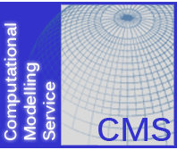




Operates / provides ground based observatories and mobile instrumentation
Data archiving and analysis services in support of UK atmospheric and EO science
Operates instrumented BAe-146 aircraft provided by BAE SYSTEMS
Provides access to Unified Model code on UK HPC facilities
Operates Chilbolton radar and MST radar (Capel Dewi near Aberystwyth)
Notes:
Homing in some more on the work under the ‘Facilities and Services’ heading, the boxes on the left hand side refer to measurement activities, while those on the right refer to computing, data storage and handling.
FAAM is an instrumented aircraft. The aircraft itself is based at Cranfield University in ?. NCAS scientists often fly field campaigns, in which the aircraft can be deployed anywhere in the world in support of national and international research programs. NCAS staff provide the expertise in operating the instruments and optimising their use to best capture the data needed for a particular program. There are a whole suite of instruments that can be interchangeably put onto and taken off the aircraft as needed. These include radiometers, and instruments for measuring aerosol concentrations and cloud condensation nuclei, also core instrumentation that records flight details and atmospheric parameters such as pressure, temperature and humidity.
AMF is the Atmospheric Measurement Facility. AMF scientists operate ground based instruments such as the NCAS mobile radar, lidars and many instruments for measuring air quality, such as detecting concentrations of atmospheric pollutants (gaseous and particulate).
CMS (Computational and Modelling Service) and CEDA are described in more detail in the following slides.

Slide 5
NCAS Computational Modelling Services (CMS)

Slide 6
NCAS Computational Modelling Services (CMS)
CMS staff undertake NCAS activities in support of computational science (particularly High Performance Computing (HPC) and numerical modelling)
Provide underpinning infrastructure, such as code repositories and workflow management tools, for the UK academic atmospheric and polar science communities.
Provide training for scientists:
NCAS Introduction to Scientific Computing course
NCAS Introduction to Unified Model course
NCAS CF Python tools course

Slide 7
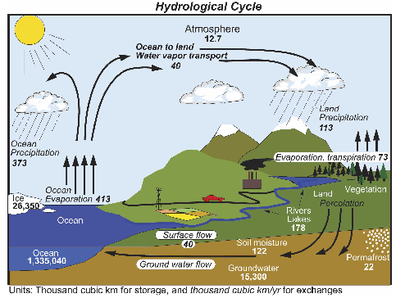
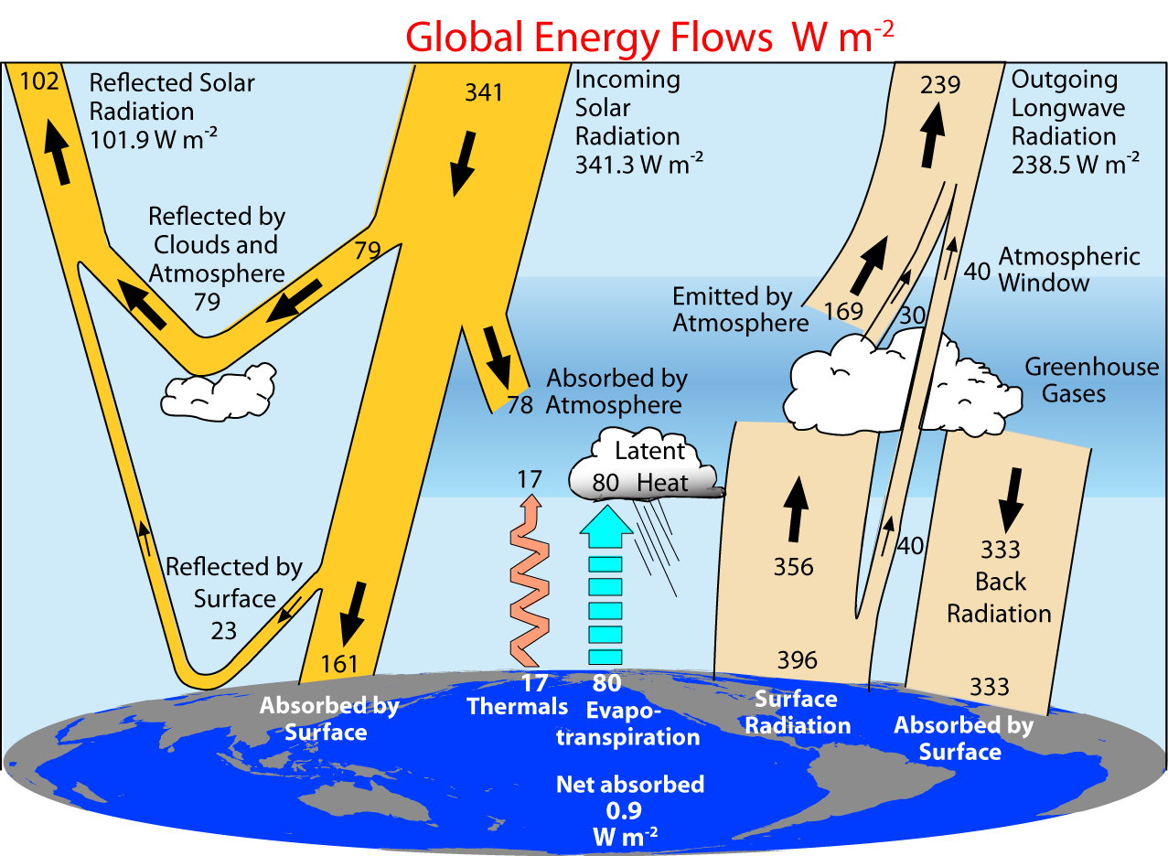
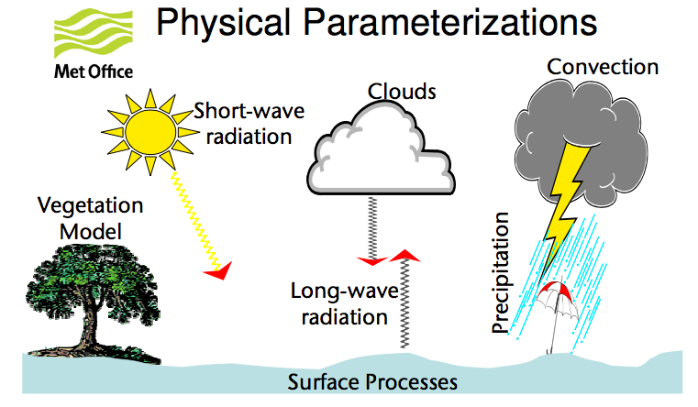
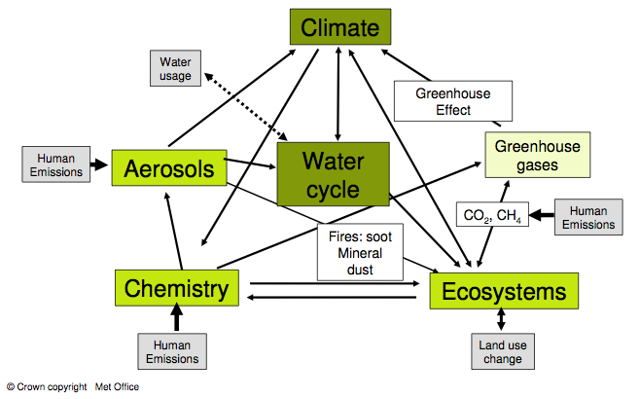
Climate Modelling
(Trenberth et al, 2007,2009)

Slide 8
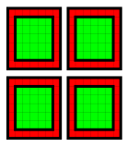
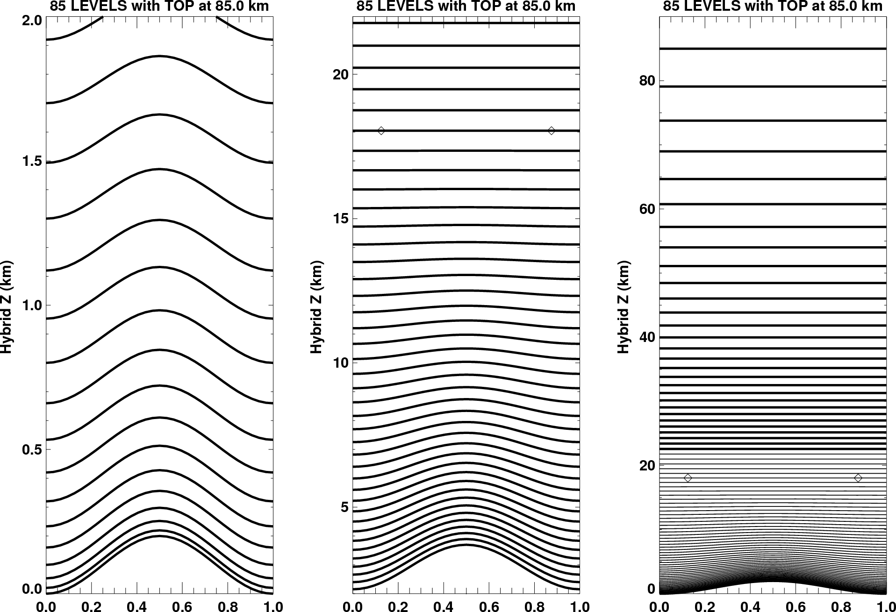
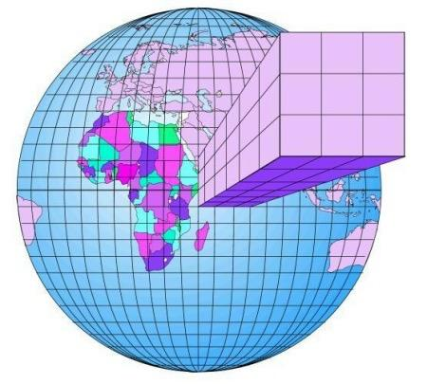


PARALLEL Implementation
Regular, Static, Lat-Long Decomposition
Mixed mode MPI/OpenMP
Asynchronous I/O servers
Communications on demand for advection
Multiple halo sizes
Land surface
Vertical resolution
Horizontal resolution
Notes:
This slide illustrates that the computations are carried out by breaking down the global model into horizontal grid boxes and vertical levels. The resolution can vary from several degrees lat-lon and, say, 30 levels to just a few km in the horizontal and 100 levels in the vertical. Each model resolution has to work with the underlying software, such as MPI parallel libraries.

Slide 9
Global Models
N96 | N144 | N216 | N320 | N512 | N768 | N1024 | N2048
(192 x 145) | (288 x 217) | (432 x 325) | (640 x 481) | (1024 x 769) | (1536 x 1152) | (2048 x 1536) | (4096 x 3073)
~135 km | ~90 km | ~60 km | ~40 km | ~25 km | ~17 km | ~12 km | ~6 km
 | NWP | Climate
Run length | 10 day operational forecast, 15 day ensemble forecast | Months (seasonal) Years, decades, centuries+
Global resolution | Testing: N320 (40 km) with 15 min ts Operational: N768 (17 km) with 7.5 min ts | Low resolution: N96 (135 km) with 20 min ts High resolution: N512 (25 km) with 15 min ts
Dynamics | Non-bit reproducible | Bit-reproducible
Notes:
Here are some examples of the different model configurations that are available, their horizontal resolutions, and their scientific uses.

Slide 10













NCAS supported MACHINES
PUMA
NOC
Code repositories
Clustervision
UM submission
Lander
HPC Wales
MONSooN
Cray XC40
Fujitsu
Cray XC30
MASS
Local
RDF
Jasmin
user ssh to all
Notes:
It is good to mention that this is a large model (shown previously on slide 7 & 8) to simulate on a single desktop/laptop hence requirement to use HPC. Depending on which institution a scientist is based at, and which projects they are working on, they will have access to one or more HPC facilities.

Slide 11

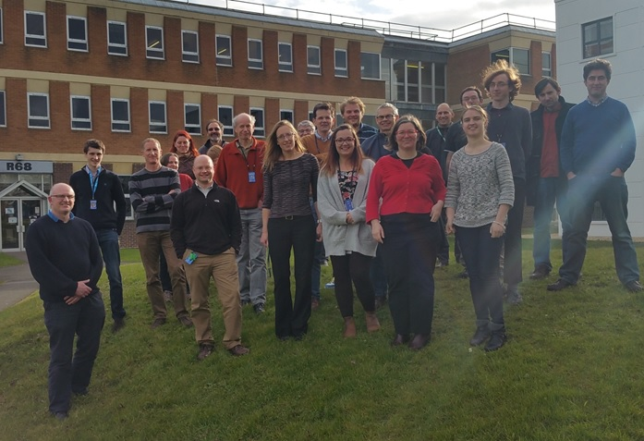

Slide 12






NERC Data Centres
NERC supports five data centres covering a range of discipline areas:
British Oceanographic Data Centre (Marine)
Centre for Environmental Data Analysis Archive (Atmospheric and Earth Observation)
Environmental Information Data Centre (Terrestrial and freshwater)
National Geoscience Data Centre (Geoscience)
Polar Data Centre (Polar and cryosphere)
Notes:
N.B. Computer scientists sometimes mean a machine room when they use the term “Data Centre”, but here we mean it in the wider sense of an actively curated archive. Staff at NERC data centres provide user support for those wanting to archive and access data, besides maintaining the physical archive itself.

Slide 13
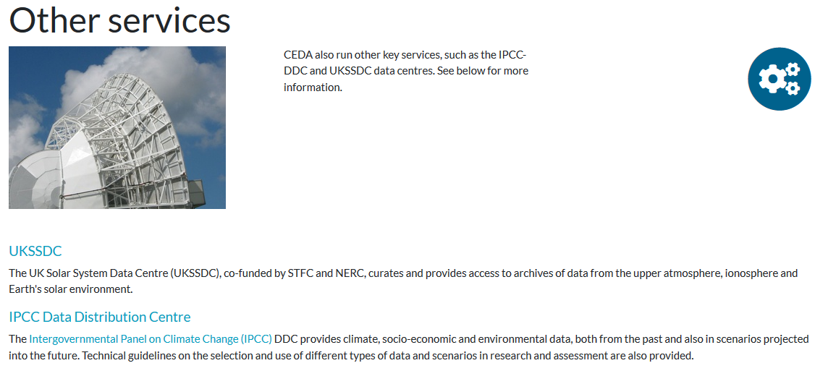
CEDA Data Centres
IPCC – Intergovernmental Panel on Climate Change Data Distribution Centre
UKSSDC – UK Solar System Data Centre
www.ceda.ac.uk
Notes:
We’ve seen that NERC has established a number of data centres and that their collective data holdings can be searched in a catalogue.
So what is CEDA and how does it fit into the NERC data centre organisation? The acronym CEDA stands for “Centre for Environmental Data Archival”. If you go to the CEDA home page at www.ceda.ac.uk and click on Data Centres in the top menu bar you will find a page showing a number of logos. Besides the main CEDA archive which contains atmospheric and EO data, there are two more: UKSSDC (UK Solar System data centre) collects data on solar-terrestrial physics; IPCC Data Distribution Centre exists to make climate prediction data from models available the climate impacts community (e.g. people studying effects of climate change on availability of fresh water). These last two are not funded in the same way as the NERC centres, nevertheless they archive data for their respective communities as do BADC and NEODC. Collectively, these four data centres have been given the umbrella title of CEDA.

Slide 14
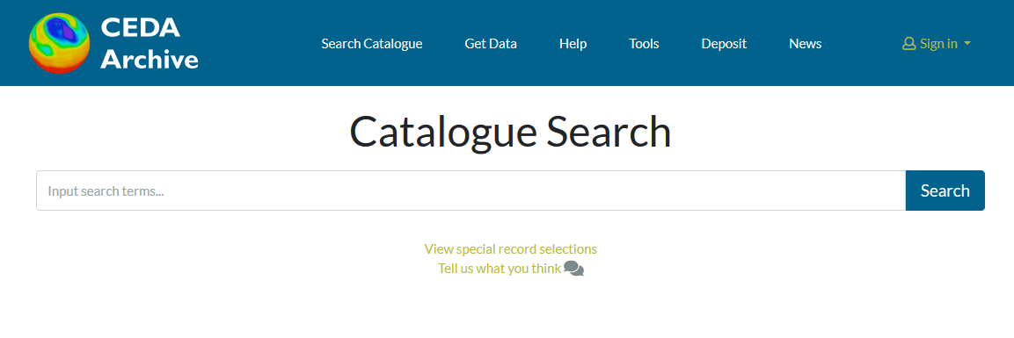
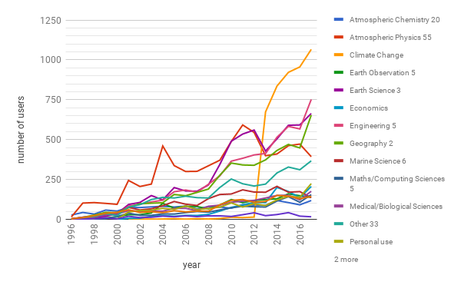
CEDA Archive (March 2019)
Data Type | Data Volume (Petabytes)
Earth Observation | 10
Atmospheric Science | 3.4
Total | 13.4 PB
Search the data catalogue
Download data
Deposit data
Users by Discipline
> 5734 datasets
In 630 dataset collections
~ 206 million files
> 55,000 registered users
Notes:
Data volume via CEDA archive app(http://cedaarchiveapp.ceda.ac.uk/cedaarchiveapp/fileset/index/?search=%2Fbadc%2F). Search /badc for atmospheric, /neodc for EO – scroll to bottom for totals. No of files via same search.
No of registered users is from CEDAdb (http://cedadb.ceda.ac.uk/admin/udbadmin/user/?q=) – scroll to bottom for total. Some are duplicates, and its for everyone that’s registered ever. Not actually active users.
Users by discipline is harder to update. Need to find where this info came from – waiting for Victoria to come back.
That is a large amount of data and a lot of computers, but CEDA is staffed by just 26 people.
CEDA staff regularly collaborate with atmospheric and environmental scientists and other data scientists through participation in national and international projects.

Slide 15
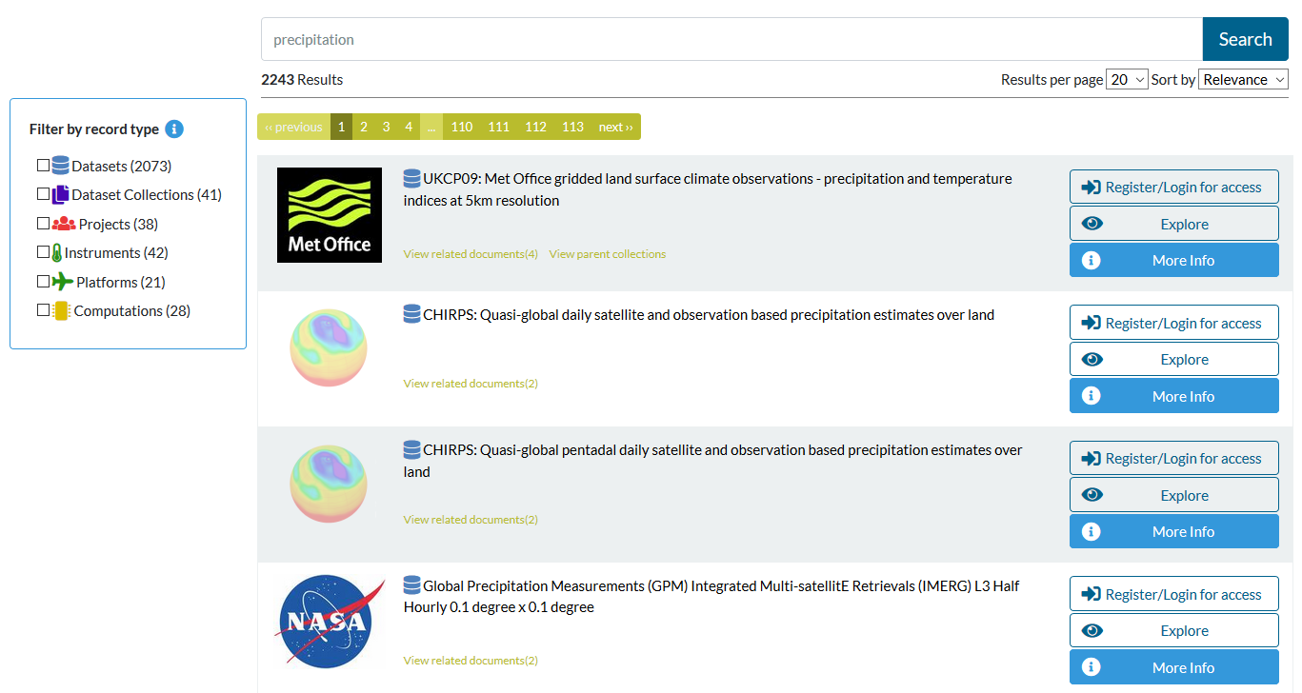
https://catalogue.ceda.ac.uk

Slide 16
What is the role of CEDA?
Preserve the science record (for data produced by NERC funded research).
Facilitate data use (for any data that compliments NERC research in Atmospheric sci or Earth Observation (EO)).
Support data standards (for international science community), e.g. ESA Climate Change Initiative; CMIP (Climate Model Intercomparison Project) data request; Climate-Forecast (CF) metadata convention.
Engage with global community. CEDA staff participate in:
World Climate Research Programme (WCRP);
Committee on Earth Observation Satellites (CEOS);
Earth System Grid Federation (ESGF);
Intergovernmental Panel on Climate Change (IPCC) Data Distribution Centre.

Slide 17
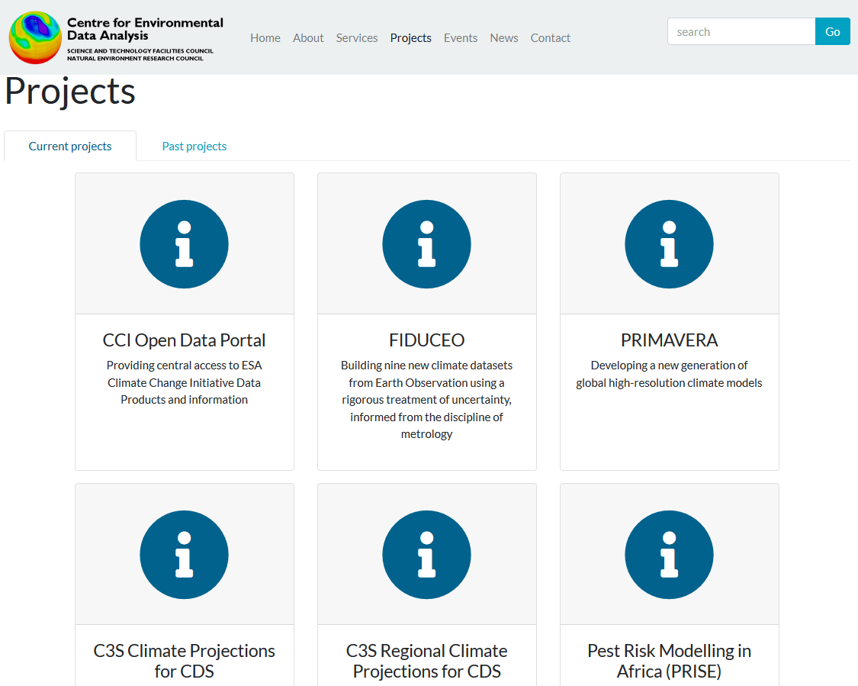
CEDA Projects
Lots more

Slide 18
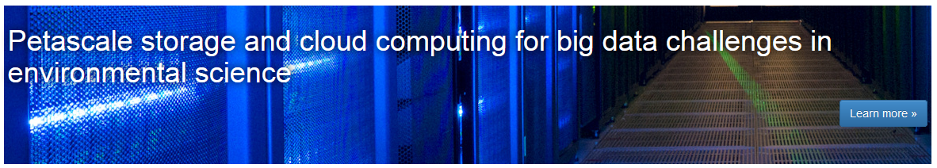
JASMIN Overview
The JASMIN facility is a "super-data-cluster" which delivers infrastructure for data analysis.
It is a hybrid between super-computer and data-centre which provides a globally unique computational environment.

Slide 19






To address “one of NERC’s most strategically important challenges: the improvement of predictive environmental science.” Prof. Duncan Wingham, NERC Chief Exec.
JASMIN is a world leading, unique hybrid of:
44PB high performance storage by end of 2018
High-performance computing (~ 12000 cores)
Large scale near line tape storage
Custom sophisticated network architecture
Innovative cloud hosting capabilities
Notes:
JASMIN = Joint Analysis System Meeting Infrastructure Needs. A “Super Data Cluster” not a “Super Computer”
1700 users

Slide 20













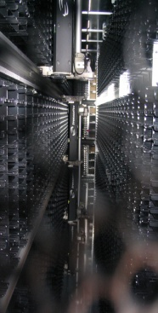
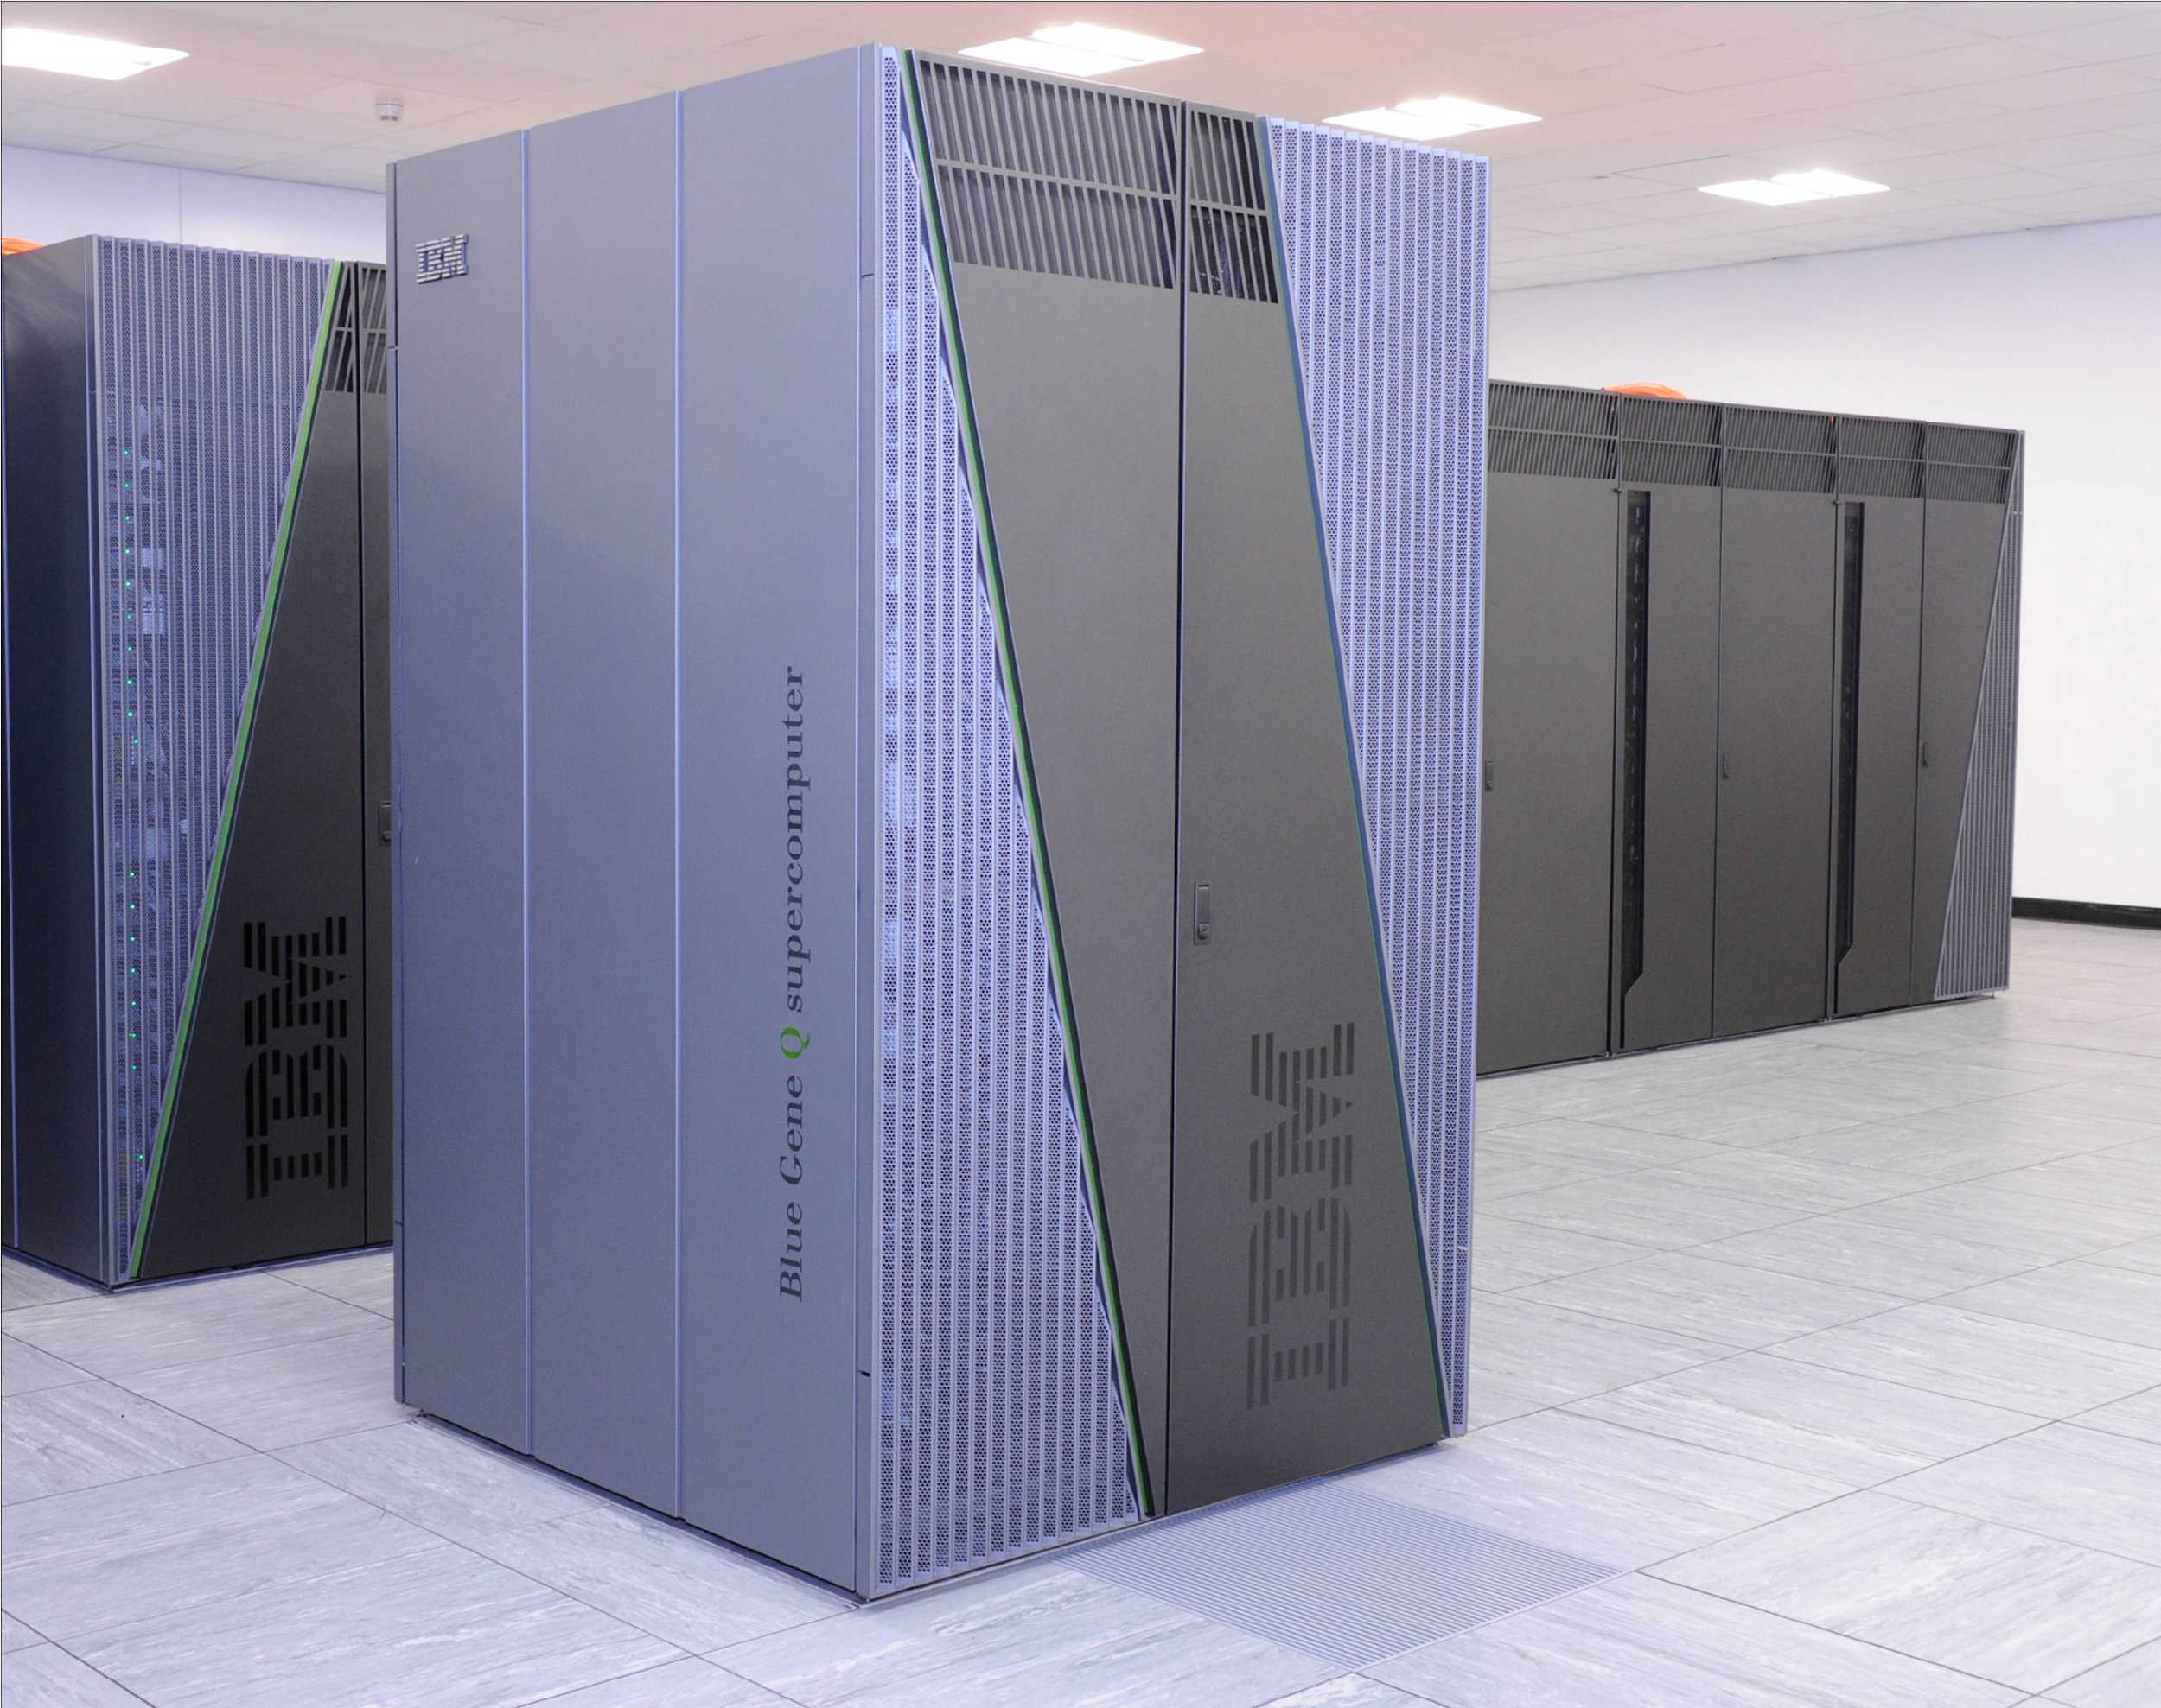
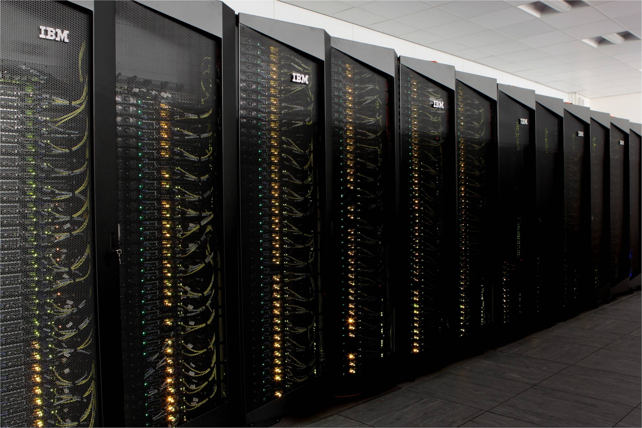










Hosted by STFC Scientific Computing Department
“Computing Expertise across length scales from processes within atoms to environmental modelling”
Applications development and support,
Compute and data facilities and services
Research and Training
Numerical Analysis
High Performance Computing
Emerald GPU cluster for Oxford, UCL, Southampton, Bristol.
SCARF HPC for RAL
Hartree: Blue Joule bluegene HPC
Hartree: Blue Wonder idataplex HPC
JASMIN: NERC super data cluster
Data Services
STFC: Facility Archives (ISIS, Diamond)
LHC: UK Hub (Tier 1 archive)
BBSRC: Institutes data archive
MRC: Data Support Service
NERC: CEDA backup and JASMIN elastic tape
Close working partnership with industry
NW-VEC
CFMS

Slide 21
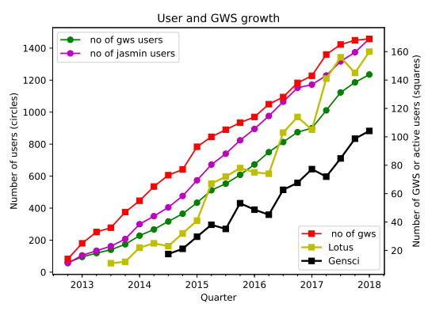
JASMIN Community
>2000 registered JASMIN users
~1500 system login accounts
~200 active projects
Group Workspaces
Cloud Tenancies
Consortia
Communities organised by science domain

Slide 22


JASMIN brings computational power close to the data
Data Processing
Data Production
User managed cache
Data Analysis
Group Workspaces
Discover and access
External Access
Disseminate externally
CEDA Curated Data Archive
External Data
Providers
Ingestion
Notes:
Group workspaces are allocated to individual projects. One common mistake is that users think that because their data is in a GWS, it is also in the CEDA archive. NO!!! GWSs are administered only for that particular project and have a nominated manager. It’s up to the manager to take backups, if needed, but there is no guarantee that a GWS will be backed up!
The CEDA Archive is a separate chunk of storage. Registered JASMIN users have read-only access but NOT write! To move data during or after a project from a GWS to the CEDA archive, it’s necessary to have submitted a formal Data Management Plan to CEDA. This details things like what data will be stored, the volume, and how long it should be kept, etc.
The advantage is that a project that produces and/or processes data on any part of JASMIN can have access to the same data analysis software and can perform comparisons of their own data to data in the CEDA archive without having to do complex and time consuming data transfers to their own institutions.
Collaborators from many institutions can work together on one project. They can all have access to their project workspace, which allows them to share whatever data and software are needed for their work, even if none of the data is ever destined for the CEDA archive.
They can run web services on project VMs to give wider access to their data.
And all JASMIN users have access to the LOTUS part of the machine, which is for computationally expensive data analysis.

Slide 23
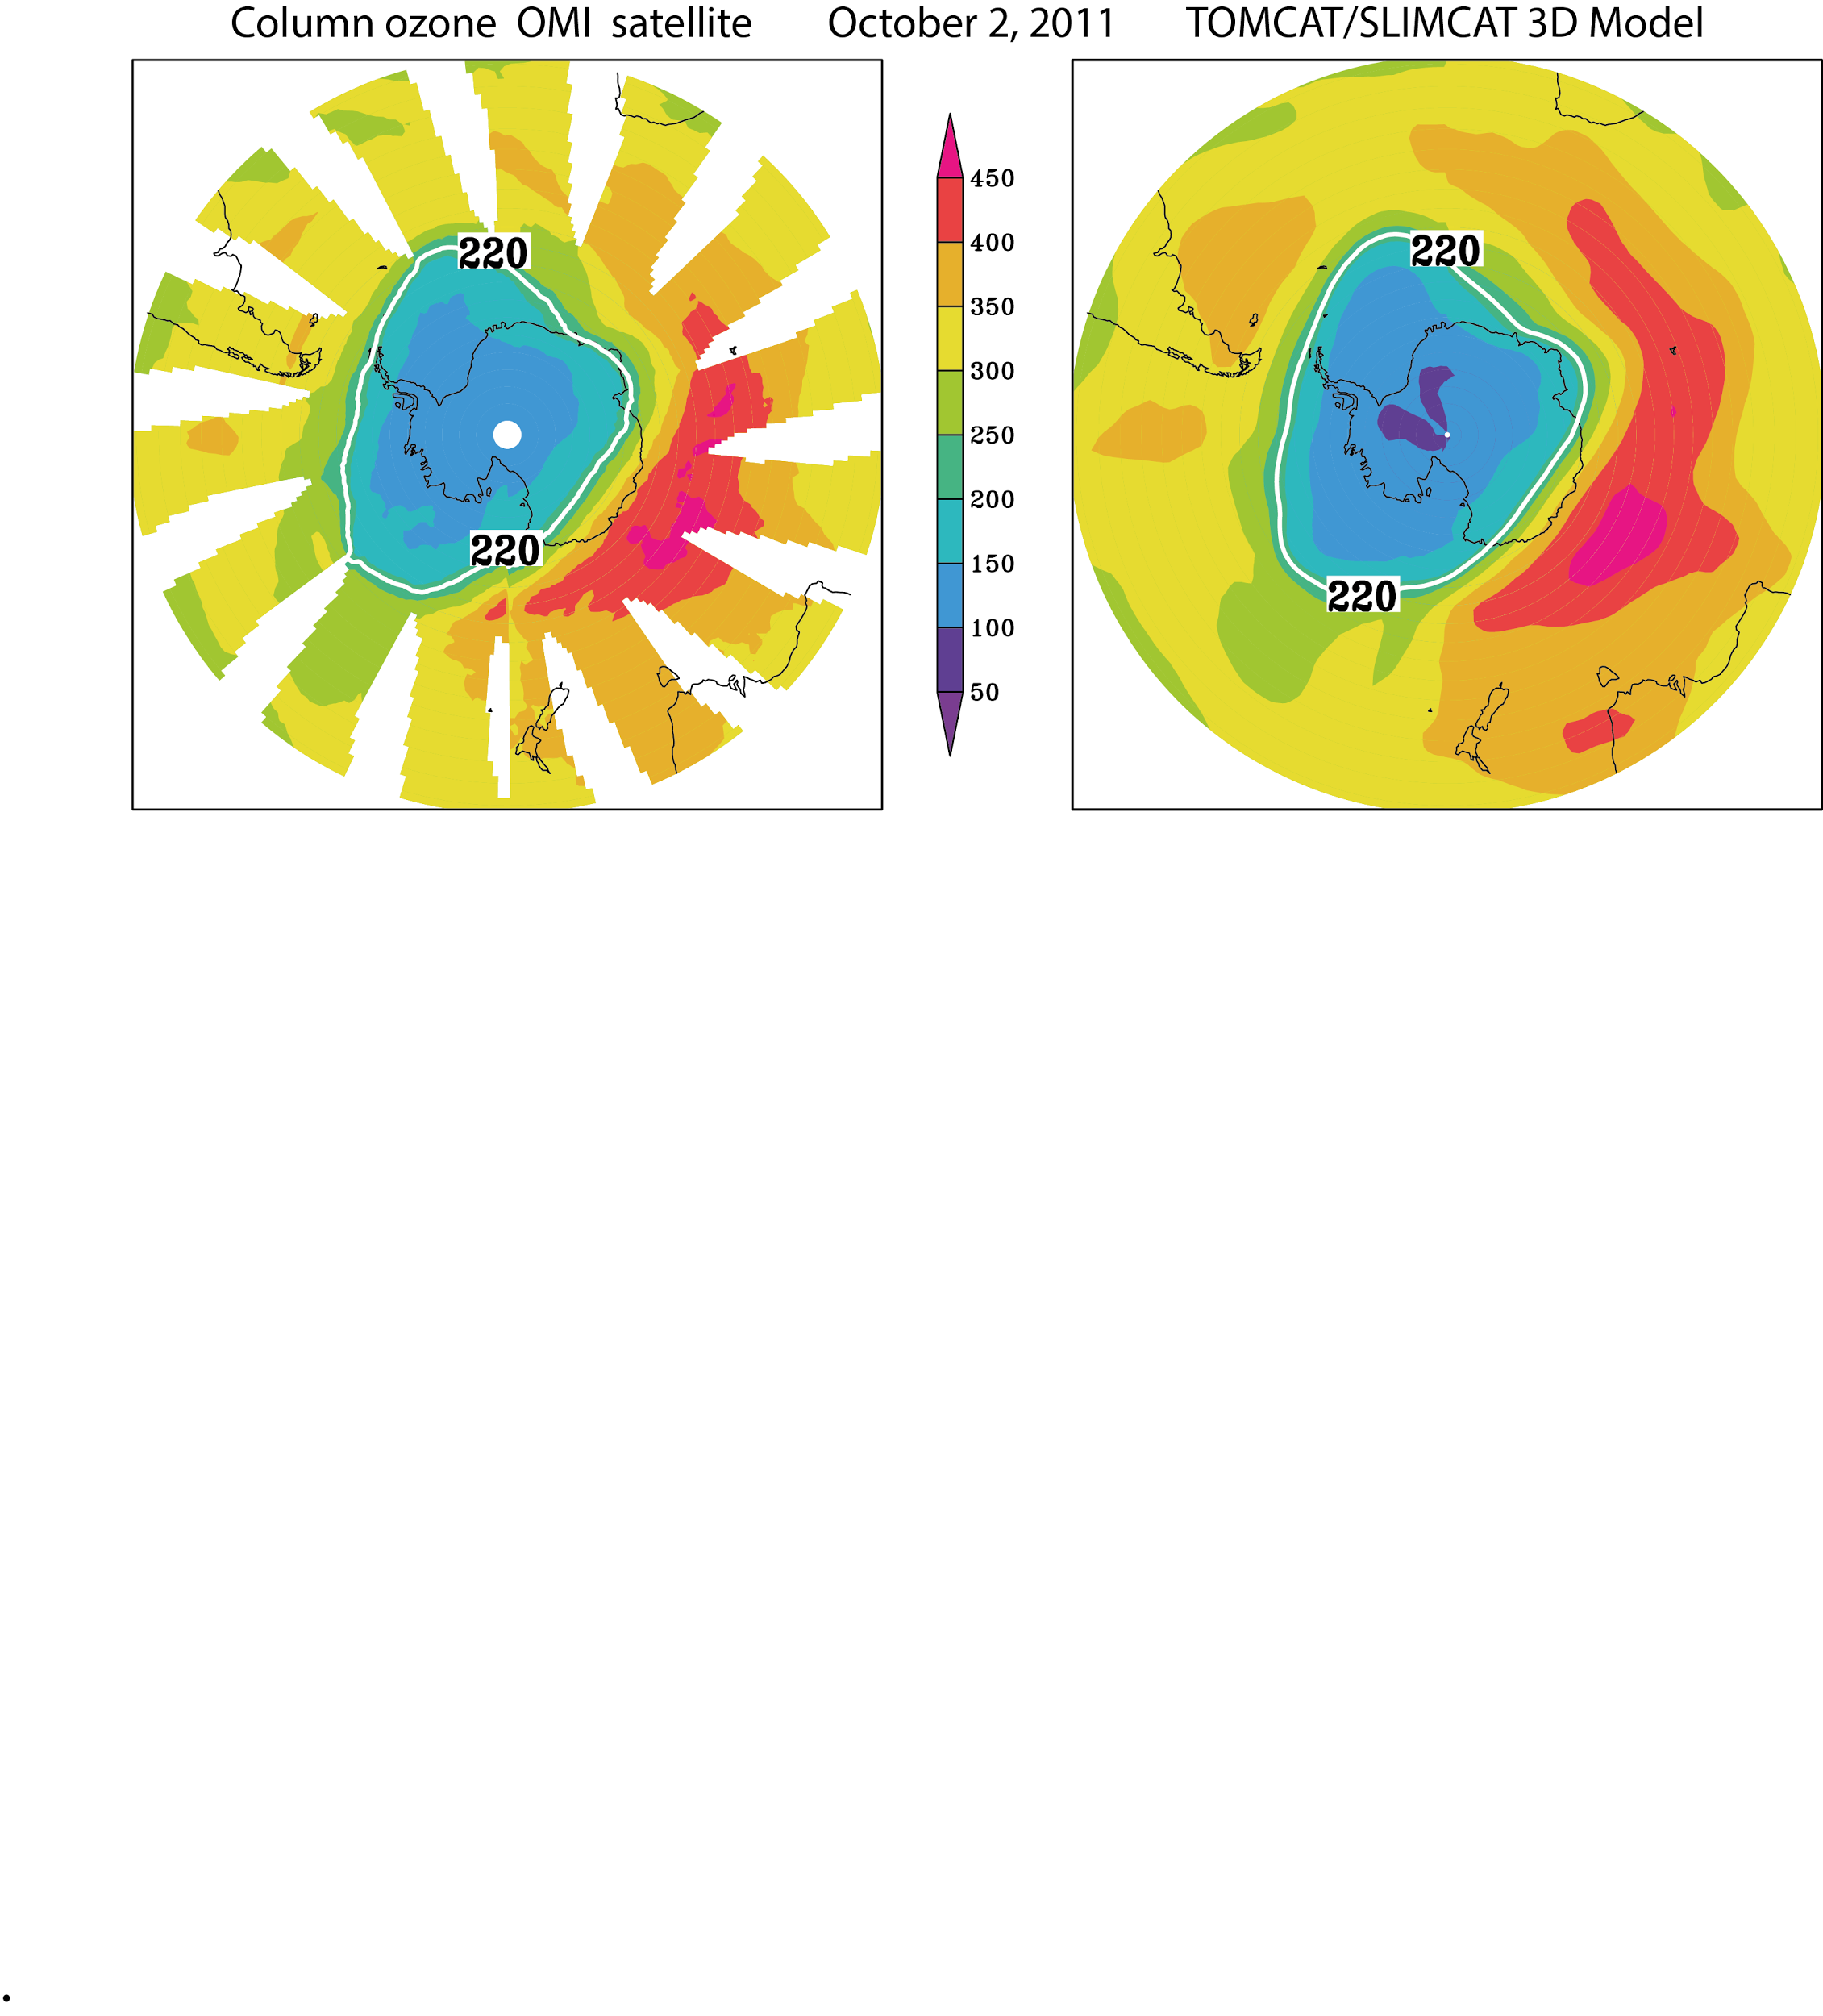
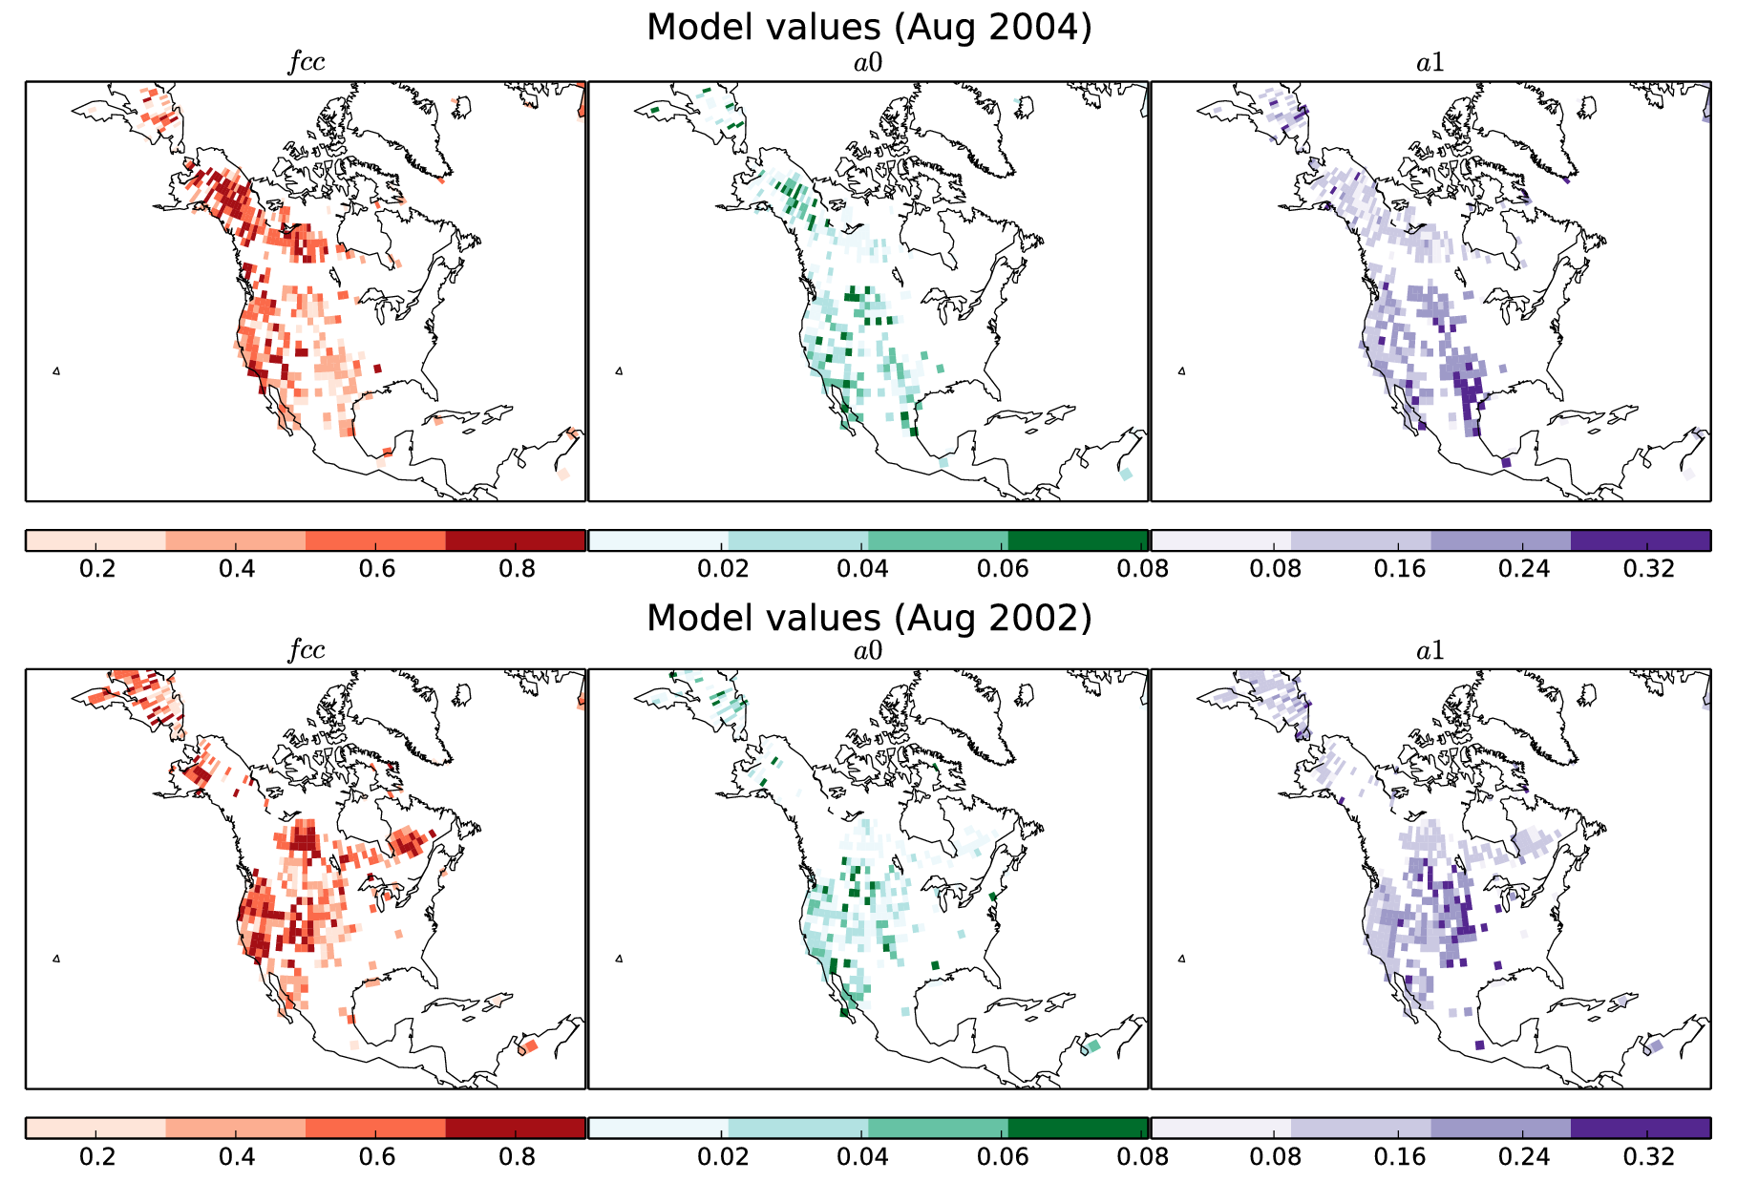
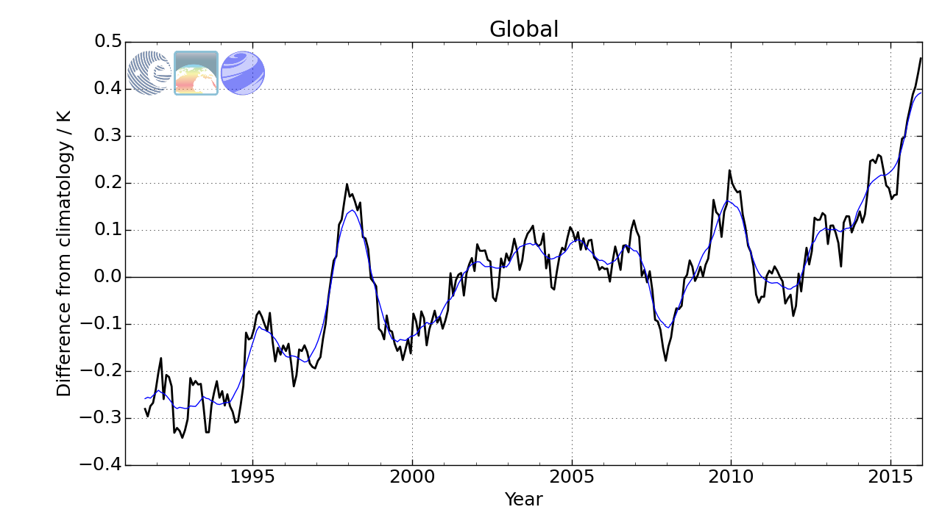
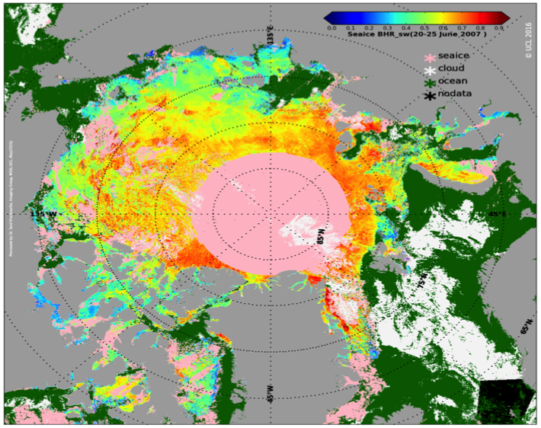
~200 Science projects on JASMIN to date
Antarctic Ozone hole: model vs. observations
Deriving the impact of fire on vegetation from earth observation data
Sea Surface Temperature from satellite observations
Climate variables from European and US instruments/satellites

Slide 24
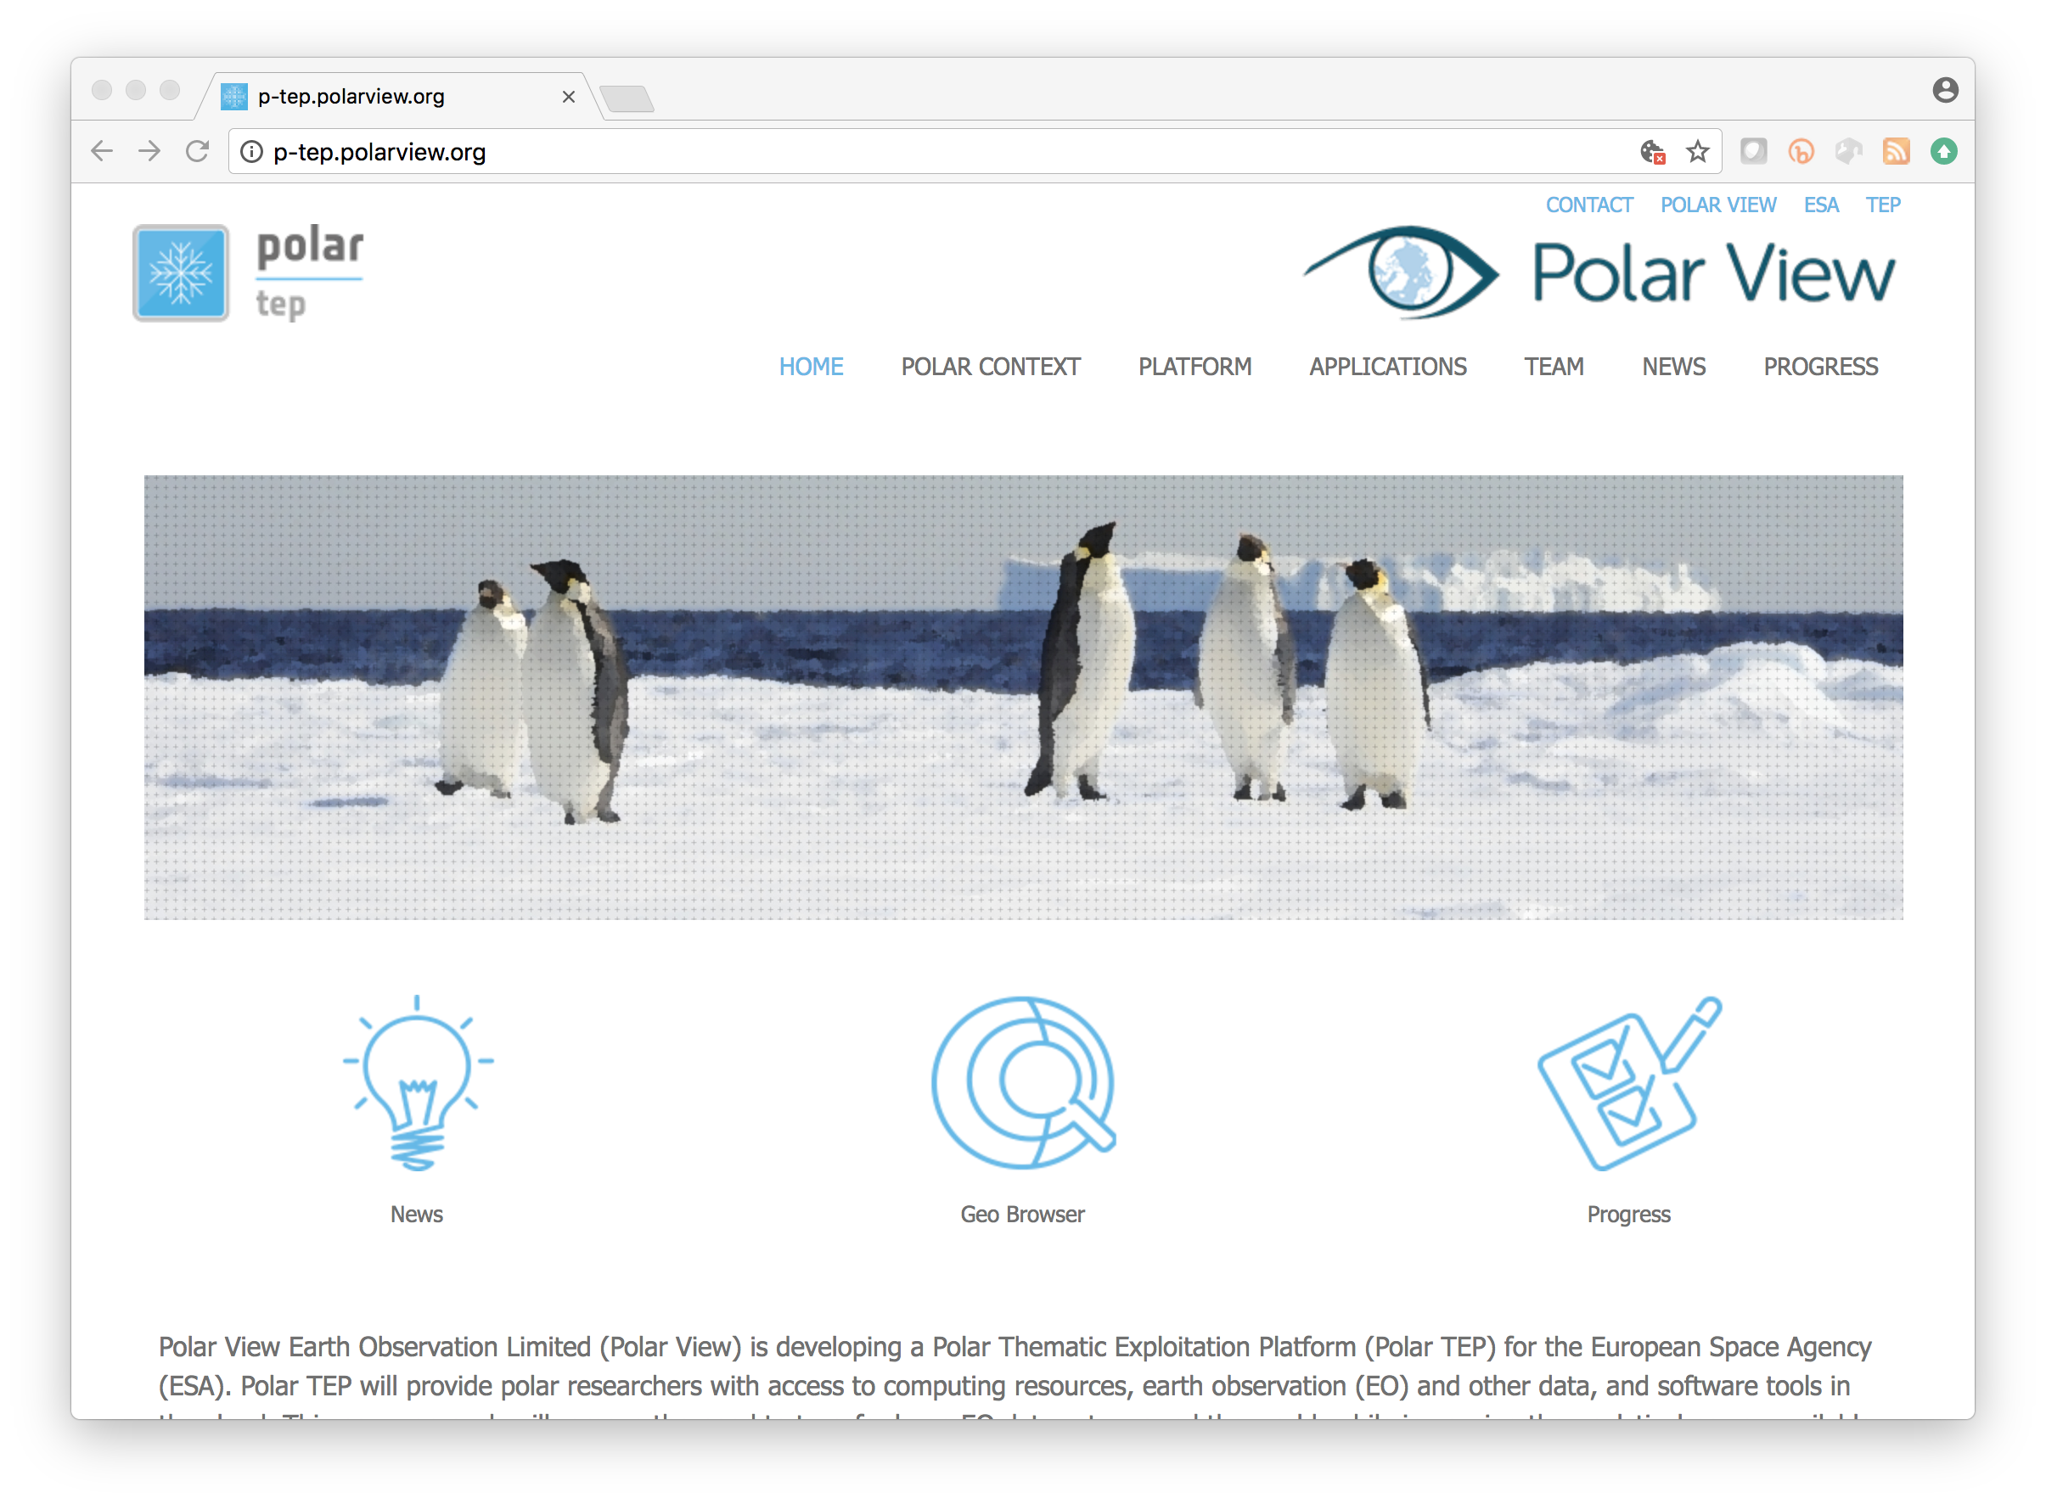
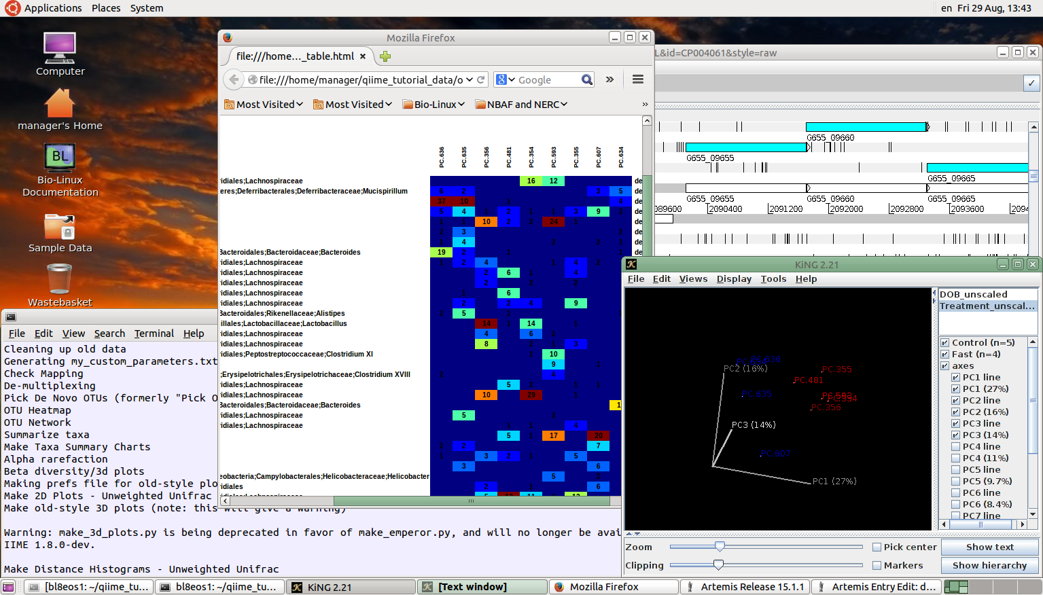
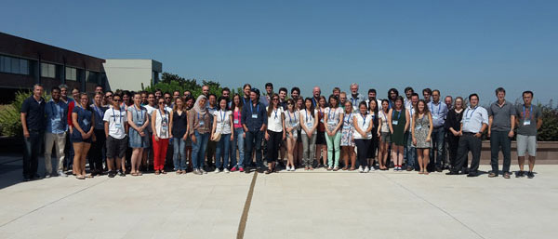
Virtual research environments on JASMIN
EOS Cloud – Desktop-as-a-Service for Environmental Genomics
ESA Polar Thematic Exploitation Platform
Attendees at ESA Summer school, ESRIN used OPTIRAD Jupyter Notebook environment
– Credit ESA
Notes:
The cloud service has developed over a number of evolutionary steps and today
hosts around twenty separate tenancies for a range of groups and collaborative projects. A number of usage patterns have emerged, for example, the
hosting of portals and web services to front data from group workspaces or the archive to
the provision of full virtual research environments such as ESA Thematic Exploitation Platforms or the NERC DataLab currently under development.
It has also been employed as a means to deliver teaching courses via Desktop-as-a-Service and Jupyter Notebook systems.

Slide 25

Logical View
CEDA Data Centres
IPCC Data Distribution Centre
ESGF
Other …
NERC Managed Analysis Compute
NERC Cloud Analysis Compute
Other compute …
CEDA Archive Services
Data Centres, Curation, DB systems
User management, External Helpdesk
Analysis Environment
Compute Cloud:
PaaS (JAP + Science VMs + User Management), IaaS, Group Workspaces: Fast Disk & Elastic Tape
External Helpdesk
JASMIN Compute and Storage
(Lotus + Community Cloud + Tape Store + Data Transfer Zone)
Internal Helpdesk

Slide 26
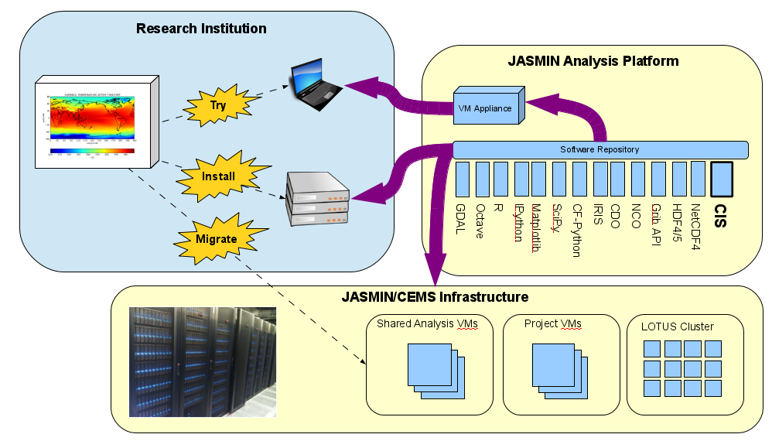
“JASPy”: a re-usable, re-deployable bundle of common tools
Notes:
JAP is installed across all JASMIN scientific servers & the batch computing clusterLOTUS. This URL should be mentioned here
https://help.jasmin.ac.uk/article/271-jap
and this https://github.com/cedadev/jasmin_scivm/wiki

Slide 27
Further Information
NCAS website: ncas.ac.uk
CMS website: cms.ncas.ac.uk
CEDA website: ceda.ac.uk
JASMIN online help: help.jasmin.ac.uk
JASPy: https://help.jasmin.ac.uk/article/4729-jaspy-envs
Social Media: @CEDAnews | LinkedIn | Facebook
CEDA Help desk: support@ceda.ac.uk
CMS Help desk: cms-support@ncas.ac.uk

